Slide 1



BIKE STORE
MANAGEMENT SYSTEM
WEEKLY REPORT
TEAM MEMBERS
1. MD. NASIM AHMED 2232936042
2. MD. ABIR HASAN 2021833642
3. MD. MURAD UL MOMIN 2232360642

Slide 2
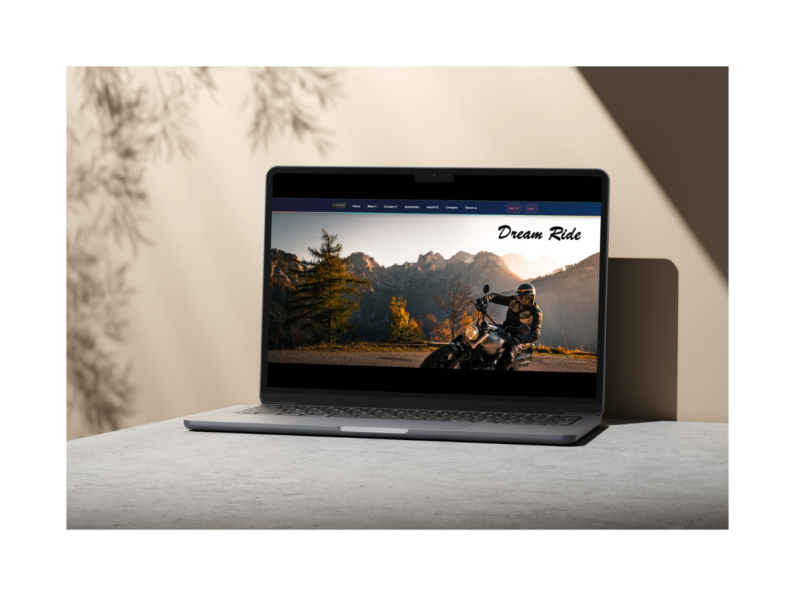
Introduction
The Bike Store Management System is a dynamic web platform designed to manage and showcase bike products.
This week, we focused on enhancing five major components to improve the user experience and product visibility.

Slide 3
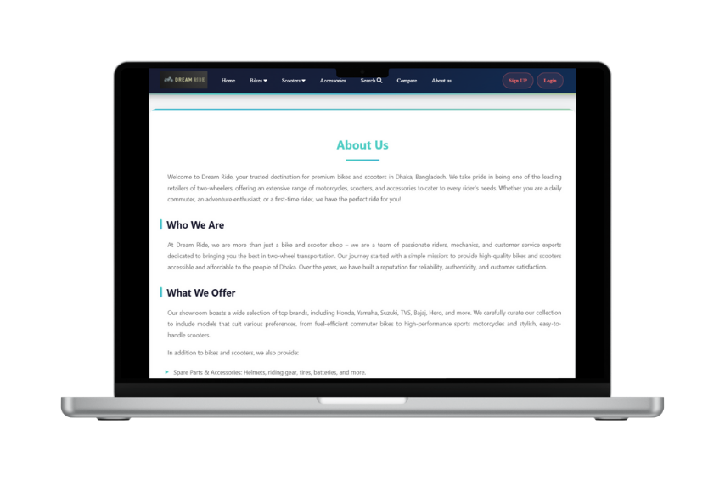
Work Completed
A. ABOUT US PAGE
DEVELOPED TO COMMUNICATE KEY SERVICE DETAILS.
SUBSECTIONS: WHAT WE OFFER, WHY CHOOSE US?, LOCATION, QUALITY, AND SERVICE.
B. SHOW PRODUCTS
DISPLAYS BIKE IMAGES DYNAMICALLY FROM THE DATABASE USING PHP.
RESPONSIVE GRID LAYOUT STYLED WITH CSS.
C. PRODUCT INFO
SHOWS DETAILED SPECS: MODEL, ENGINE, PRICE, FEATURES.
D. SHOW BRANDS
DISPLAYS CURRENT AND UPCOMING BRANDS.
HELPS USERS VIEW INVENTORY AND FUTURE AVAILABILITY.
E. COMPARE
USERS CAN COMPARE UP TO THREE BIKES SIDE-BY-SIDE.
ATTRIBUTES: ENGINE, MILEAGE, PRICE, QUANTITY, AND RELEASE DATE.

Slide 4
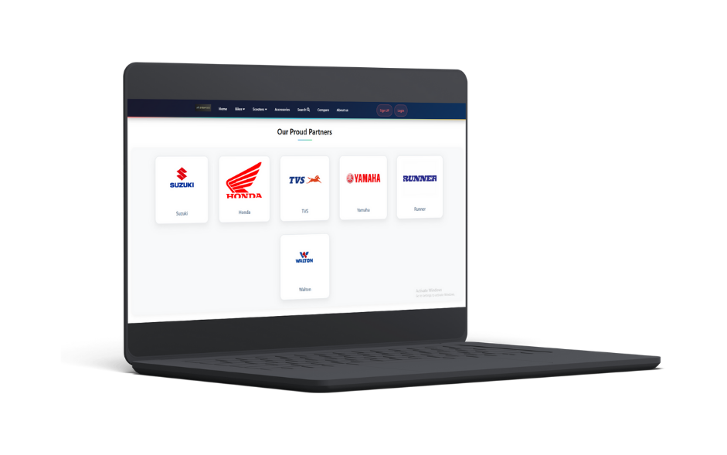
Conclusion
THIS WEEK, WE COMPLETED 5 CORE FEATURES USING PHP FOR DYNAMIC DATA HANDLING AND CSS FOR A CLEAN INTERFACE.
USERS CAN NOW:VIEW AND COMPARE BIKES, BROWSE BRANDS ,LEARN ABOUT THE STORE.

